Slide 1

News Classifier EDA
Chow Jun Wei and Esraa Sultan
Group name: Jun and Esraa
24 November 2021

Slide 2
Required Team member details
Required Team member details
Name | Chow Jun Wei | Esraa Sultan
Email | Jun.chow.18@ucl.ac.uk | Alzahrani.Esraa1@gmail.com
Country | Brunei Darussalam | Saudi Arabia
College/Company | NIL | Esri Saudi Arabia
Specialization | Data Science, NLP, Data Analyst | Data Science

Slide 3

Problem Definition - To classify a (group of) sentence(s) into their corresponding category. We have 20 categories.
Comp.graphics | Comp.os.ms-windows.misc | Comp.sys.ibm.pc.hardware | Comp.sys.mac.hardware
Comp.windows.x | Rec.autos | Rec.motorcycles | Rec.sport.baseball
Rec.sport.hockey | Sci.crypt | Sci.electronics | Sci.med
Sci.space | Misc.forsale | Talk.politics.misc | Talk.politics.guns
Talk.politics.mideast | Talk.religion.misc | Alt.atheism | Soc.religion.christian

Slide 4
Purpose of this presentation
To show how the data looks like, whenever possible. We do not yet show any recommendations from this presentation.

Slide 5
The next few slides contain information on before we clean the data

Slide 6
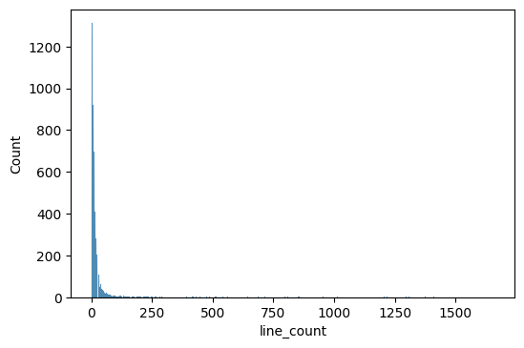
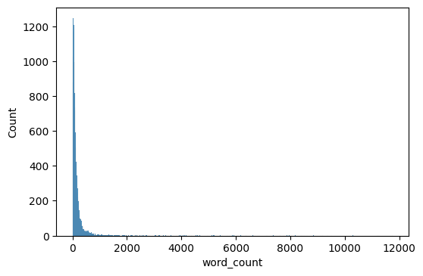
Line number count and word count
Most contains only a few sentences; but some are very long

Slide 7
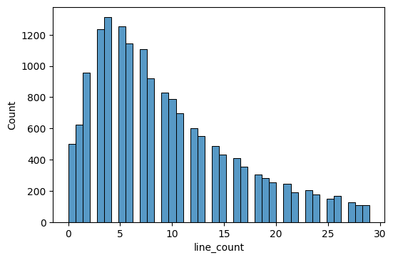
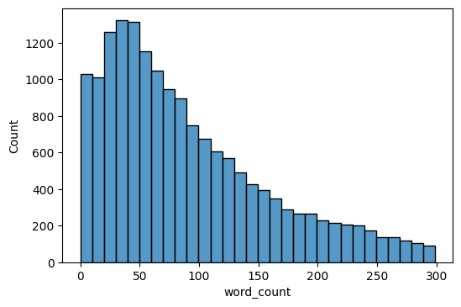
Zoomed in to small range

Slide 8
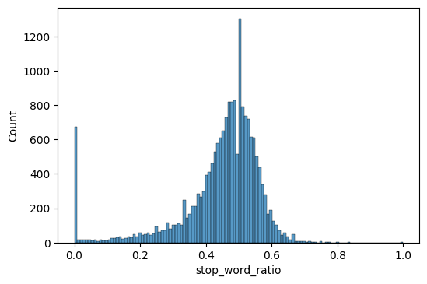

Stop words per word count ratio
On average, half of the words per article are considered stop words

Slide 9
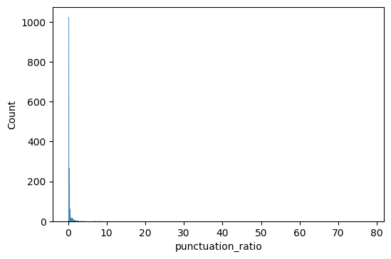
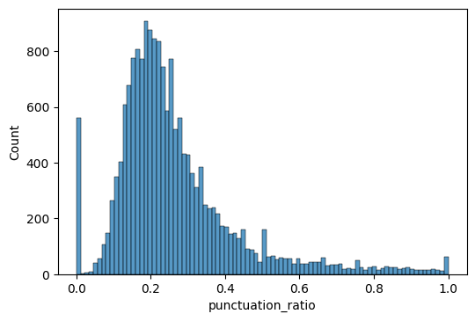
Punctuation to Word Ratio
Full
There contains a long-tailed distribution, but mostly followed Poisson distribution where it’s not at the tail.
Zoomed in

Slide 10
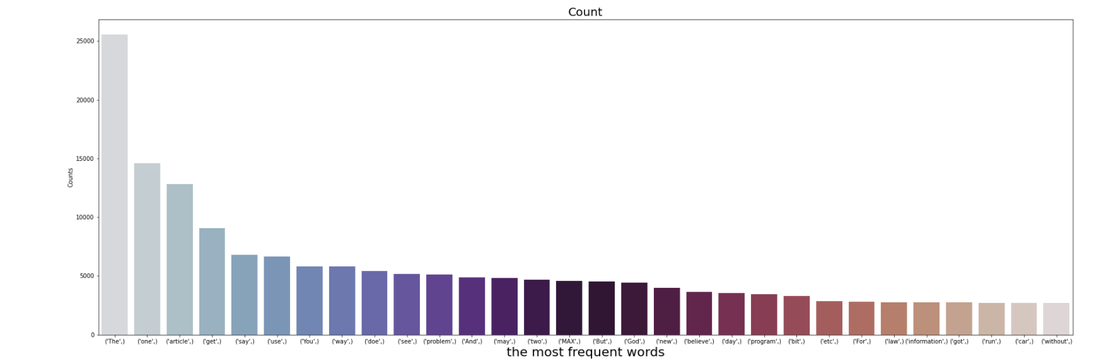
The most frequent words in all the data.
-

Slide 11
What changes after cleaning
Not much changes are noticed after cleaning. The statistics does shift a bit (by 0,002) but that’s almost negligible.

Slide 12
Unigrams, Bigrams, Trigrams
The actual table is too huge to put here. We would summarize them in the next three slides.

Slide 13
Unigrams
Top 3 common words: don’t, think, know.
Top 3 uncommon words: image, space, god.
Conclusion: Not much information extracted from unigrams to distinguish between categories.

Slide 14
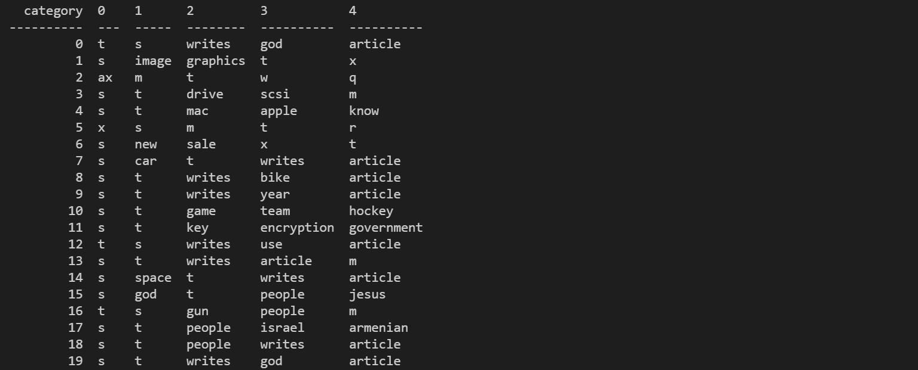
Unigrams

Slide 15
Bigrams
Top 3 common words: don’t think, don’t know, does know.
Uncommon words gives better indications here. Examples: space station, human rights, medical newsletter, image processing, hard disk, etc.
Can separate major categories (between science and politics, for example) but not really for sub-categories (sci.crypt vs sci.electronics).

Slide 16
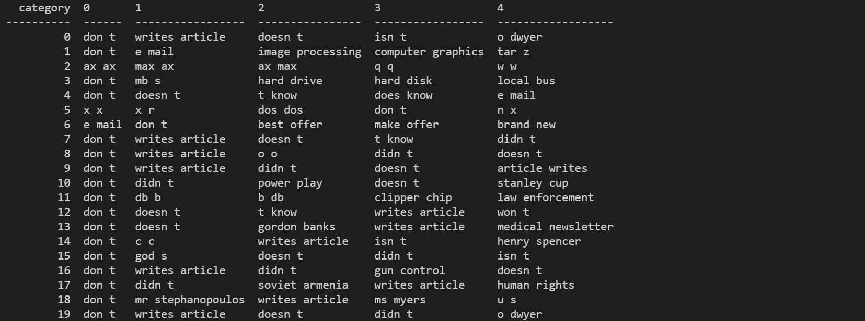
Bigrams

Slide 17
Trigrams
Top 3 common: not available.
Uncommon: emails, phone numbers, separators (=====, ------) occupy most top-k trigrams. Useful ones includes linked allocation unit for example.
They are not necessary the most useful separator between categories. Category 10 contains numbers for their top-k trigrams such as 0 0 0, 0 1 1, 2 2 2, that are not meaningful.

Slide 18
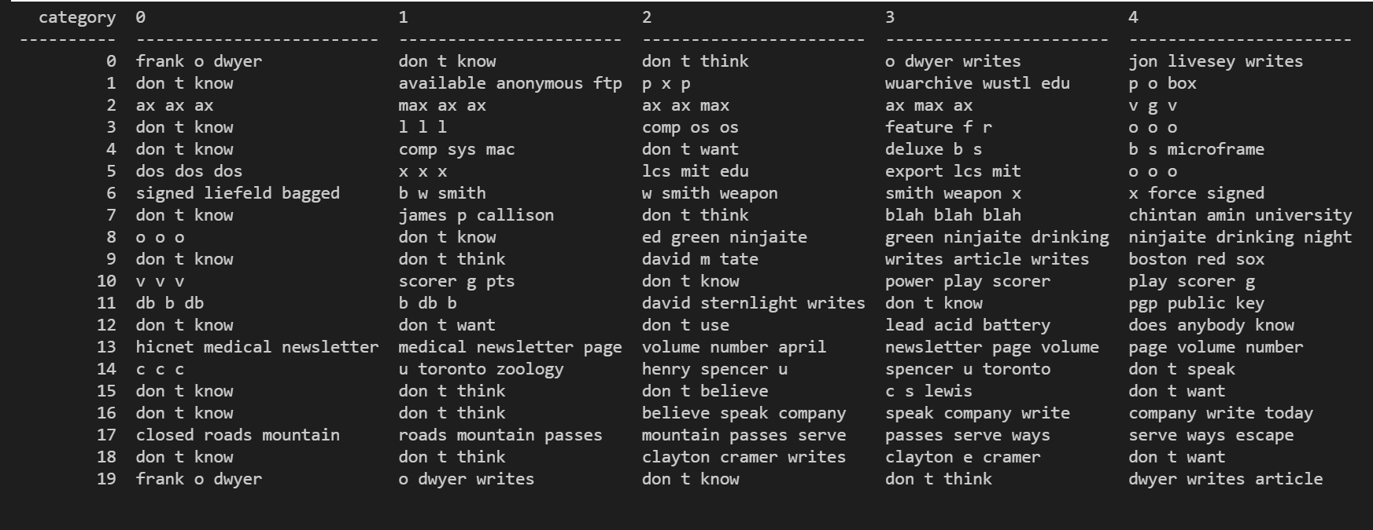
Trigrams

Slide 19
Recommended Models (Technical User)
Any Neural Net models shall do good.
One suggests the use of AWD-LSTM defaults of fastai NLP.

Slide 20
Thank You

